Slide 1
Engineering Cycle Worksheet
Jad Isidore
2021101043

Slide 2
1 DECOMPOSE the problem
What is the problem you are solving? What smaller problems can you break it into?
Big Goal:
Print “Fass” or “Fail” for a particular number if it fits within a particular range, and/or if it does not.
Subgoals:
If that number is greater than or equal to 80, output “Pass”
If that number is less than 80, output “Fail”

Slide 3
1 DECOMPOSE the problem
Based on your understanding of the problem, make an educated guess about which coding concepts you will use.
Coding concepts:
I believe that I may have to use conditional statements and variables in this lab.

Slide 4
2 PLAN a solution
How should your algorithm solve the problem? Plan your solution in plain English or pseudocode.
First, I have to…
Establish all my variables.
Then I have to…
Devise the conditionals; the results if the condition is met and the results if it is not met.

Slide 5
2 PLAN a solution
How should your algorithm solve the problem? Plan your solution in plain English or pseudocode.
Finally, I have to…
Ensuring that all my conditions are met, and the results that will be displayed for whether it is met and/or if it is not met, begin laying out code/implementing my solution.

Slide 6
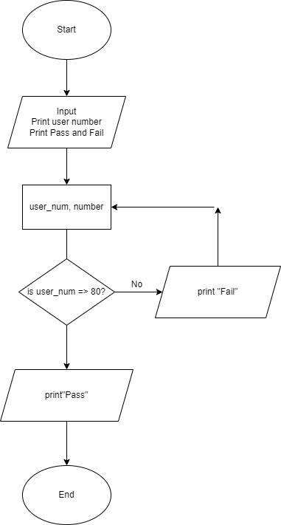
2 PLAN a solution

Slide 7
2 PLAN a solution
IPO Chart
INPUT | PROCESS | OUTPUT
user_num | if user_num => 80 = print pass | Pass
number | if user_num <80 = print fail | Fail
Pass,Fail

Slide 8
3 IMPLEMENT the solution
# Print Pass or Fail if a number meets a particular condition; greater than or equal to 80 or below 80, respectively.
# Decleration of variables
user_num = int(input("Enter your number: "))
ion = "Pass"
union = "Fail"
# Using conditionals to meet results
if user_num >= 80:
print(ion)
else:
print(union)

Slide 9
4 TEST and DEBUG the code
Type your code into the code editor. Hit “run” to see if your code does what you intended. Make sure to check your spelling, syntax and structure. Type ‘x’ for which happens, add additional where applies.
X | Code works as intended
X | Everything is spelled correctly
X | Lines are properly indented
X | Parentheses () are correct
X | Capitalization is correct
X | Variables are defined before I use them
X | Errors occurred

Slide 10
If you got no errors. Screenshot your code and the output and paste them onto this slide. If you got errors, please advance to the next slide

Slide 11
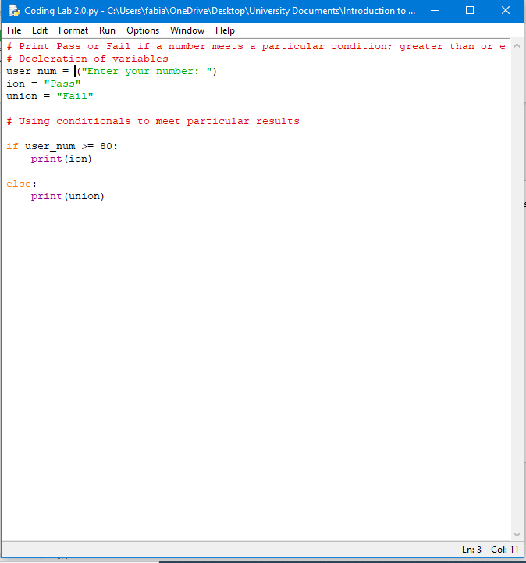
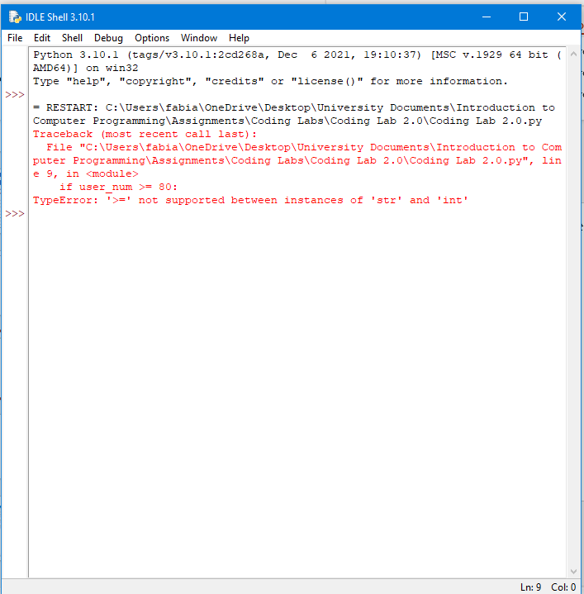
If you got errors. Screenshot your code and the error you got and paste them onto this slide.

Slide 12
What caused the error?
The proper data type was not established. Therefore, the program automatically checks it as a string, since the function “input” was used. Hence the reason, the program identified the variable “user_num” as string data type rather than integers.

Slide 13
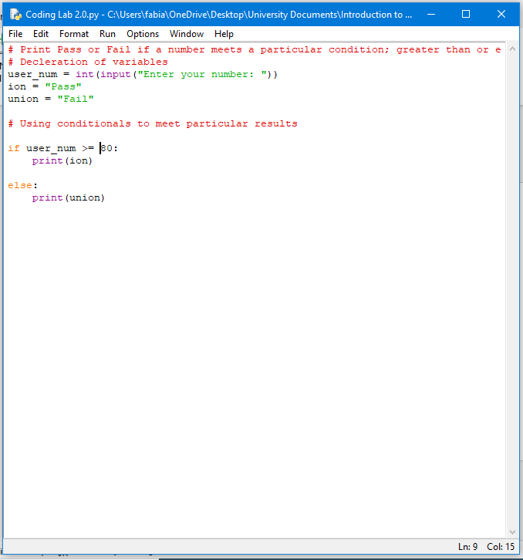
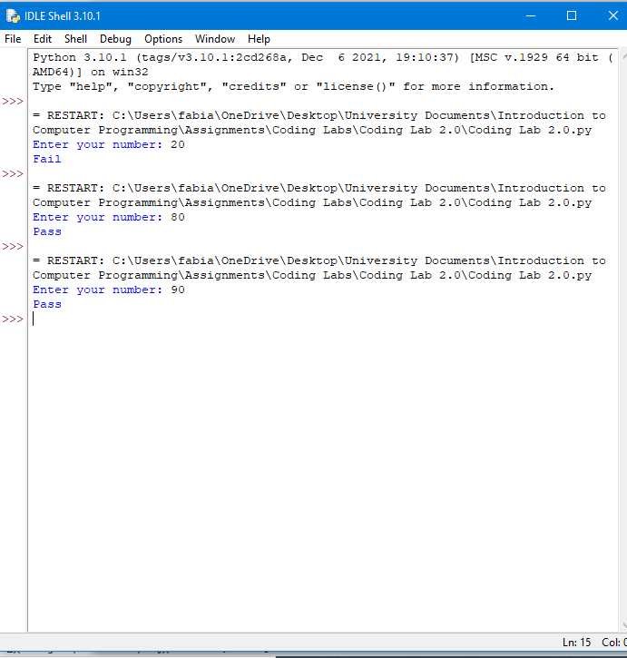
Screenshot the newly adjusted code and its output.

